Slide 1

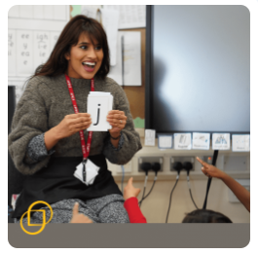

Reception Reading Meeting September 2025

Slide 2
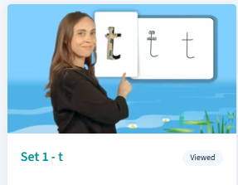
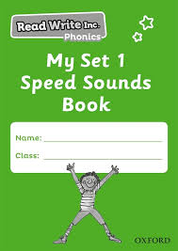
Phonics
Phonics is the code that allows us to read and write words.
We use a scheme called RWI.
We aim to teach a sound each day during our daily sessions.
Each afternoon we will share a video on Tapestry of the sound learnt that day to share with your child.
We will also send home RWI sound books for you to use with your child at home.
How to help your child learn the Read Write Inc. phonics sounds

Slide 3
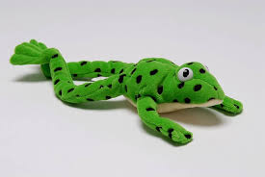
Oral Blending
Oral blending is a foundational phonics skill where a child hears a word broken into individual sounds (phonemes) and then mentally blends those sounds together to form the whole word.
For example, c-a-t becomes cat.
In your child’s book bag, we will share a selection of oral blending activities for you to play with your children at home, these activities can be recorded in their Reading Record.

Slide 4
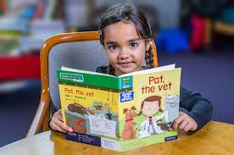
Reading Book
Your child’s first book will be a
picture book with no words.
Questions to ask your child when looking at these books will be put in their book bag.
Try to ask open-ended questions, focus on pictures, character’s feelings, make predictions, identify the title on the front cover etc.
Once the children know the first 10 sounds and are able to orally blend they move onto Read Write Inc. Phonics Storybooks which are a series of decodable texts matched to the phonics the children are learning.

Slide 5
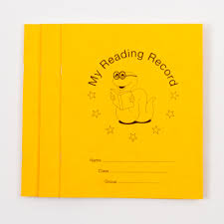
Reading Record
We ask that you read with your child
5 times a week.
Reading activities can include:
Reviewing sounds from their green sound book
Reading their book with them
Oral blending activity
Blending strip (these will be stuck in their Reading Record when your child knows the first 10 sounds)

Slide 6

Love to Read
The children will have access to a range of books which they will choose to take home based on their personal interests, preferences, abilities, lives and experiences.
These books will be taken home to
be shared with a grown up.
Love to Read books get changed
every Friday.

